Slide 1
Title:
1/73
Security and Privacy in Smart Healthcare:
A Security-Centric Transition toward Federated Machine Learning
Presenter:
Amirali Farrokhi
Supervisor:
Dr.Bahlol Rahimi
Urmia University of Medical Sciences
Winter1404

Slide 2

2/73

Slide 3
Table Of Content
3/73
1
Security & Privacy as the Foundation of Smart Healthcare
Machine Learning in Healthcare: Security Challenges
2
Federated Learning: Security-by-Design Paradigm
3
Federated Learning in IoMT and Advanced Architectures
4
Critical Analysis & Research Outlook
5

Slide 4

Why Security Comes First
4/73
Explosion of Connected Medical Systems:
  Rapid growth of connected medical devices and wearables
  Real-time data exchange across clinical and non-clinical systems
  Significant expansion of the healthcare attack surface
Healthcare as a Prime Cyber-Attack Target:
  High value and sensitivity of health data
  Operational criticality and low tolerance for system downtime
  Historically limited cybersecurity maturity in healthcare organizations
Digital Transformation of Healthcare:
  Transition from paper-based systems to digital and smart healthcare
  Widespread adoption of EHRs, AI-driven decision support, and IoT technologies
Consequences of Security Breaches:
  Direct risks to patient safety and quality of care
  Disruption of clinical workflows and healthcare services
  Loss of trust among patients, providers, and institutions

Slide 5
5/73
In healthcare, cybersecurity failures translate into clinical failures.
Ali MS, Ahsan MM, Tasnim L, Afrin S, Biswas K, Hossain MM, Ahmed MM, Hashan R, Islam MK, Raman S. Federated Learning in Healthcare: Model Misconducts, Security, Challenges, Applications, and Future Research Directions--A Systematic Review. arXiv preprint arXiv:2405.13832. 2024 May 22.
Algarni A. A survey and classification of security and privacy research in smart healthcare systems. IEEE Access. 2019 Jul 25;7:101879-94.

Slide 6

Smart Healthcare as a Complex Cyber-Physical System
6/73
Smart Healthcare as an Integrated Cyber-Physical Ecosystem
  Tight coupling of digital, physical, and human components
  Continuous interaction between information systems and clinical processes
Multi-Layer System Integration
  Clinical information systems (EHR, HIS, PACS, LIS)
  Internet of Medical Things (IoMT), wearables, and smart medical devices
  AI-driven clinical decision support and automation systems
Growing System Interdependency
  Functional dependencies across technical and organizational layers
  Failure propagation across interconnected subsystems
  Limited fault isolation in highly integrated environments
Security Implications
  Security breaches extend beyond data compromise
  Attacks can disrupt physical processes and clinical workflows
  A single vulnerability may trigger cascading system-wide failures

Slide 7
7/73
Security in smart healthcare must be analyzed at the system-of-systems level.
Fardin Quazi et al., “Data Security & Privacy in Healthcare,” IJGIS (2024).
Bajrić S. Data security and privacy issues in healthcare. Applied Medical Informatics. 2020 Mar 30;42(1):19-27.

Slide 8
Characteristics of Healthcare Data from a Security Lens
8/73
Highly Sensitive and Longitudinal Data
  Includes clinical, genomic, behavioral, and biometric information
  Longitudinal records enable deep profiling of individuals over time
  Breaches may have irreversible consequences for patients
Context-Rich and Re-identifiable
  Health data is inherently rich in contextual and auxiliary information
  High susceptibility to re-identification, even after anonymization
  Linkage attacks increase risk across multiple datasets
Extended Data Lifecycle and Persistent Exposure
  Health data must often be retained for decades
  Long storage periods increase cumulative attack probability
  Security must be sustained across evolving technological threats
High Secondary and Adversarial Value
  Valuable for insurance fraud, pharmaceutical intelligence, and targeted attacks
  Significantly higher black-market value compared to financial data
  Attractive target for both cybercriminals and state-level actors

Slide 9
Characteristics of Healthcare Data from a Security Lens
9/73
Highly Sensitive and Longitudinal Data
  Includes clinical, genomic, behavioral, and biometric information
  Longitudinal records enable deep profiling of individuals over time
  Breaches may have irreversible consequences for patients
Context-Rich and Re-identifiable
  Health data is inherently rich in contextual and auxiliary information
  High susceptibility to re-identification, even after anonymization
  Linkage attacks increase risk across multiple datasets
Extended Data Lifecycle and Persistent Exposure
  Health data must often be retained for decades
  Long storage periods increase cumulative attack probability
  Security must be sustained across evolving technological threats
High Secondary and Adversarial Value
  Valuable for insurance fraud, pharmaceutical intelligence, and targeted attacks
  Significantly higher black-market value compared to financial data
  Attractive target for both cybercriminals and state-level actors

Slide 10
10/73
Healthcare data security must be designed for decades, not deployment cycles.
Ali, M. S. et al., Federated Learning in Healthcare: Model Misconducts Explains sensitive, longitudinal, re‑identifiable, and high‑value nature of healthcare data and the security challenges in FL
Bani Issa W, Al Akour I, Ibrahim A, Almarzouqi A, Abbas S, Hisham F, Griffiths J. Privacy, confidentiality, security and patient safety concerns about electronic health records. International nursing review. 2020 Jun;67(2):218-30.

Slide 11
Security Foundations in Healthcare Systems
11/73
Extended Security Requirements in Healthcare
  Accountability: Clear attribution of actions to users and systems
  Traceability: Ability to track data access, modification, and usage over time
  Non-repudiation: Assurance that actions and transactions cannot be denied
Limitations of the Classical CIA Triad
  Confidentiality, Integrity, and Availability are foundational but insufficient
  CIA focuses primarily on technical protection of data and systems
  Does not fully address accountability and trust in complex healthcare environments
Security as a Clinical Enabler
  Security mechanisms must align with clinical workflows
  Overly restrictive controls may compromise patient care
  Security should ensure safe, continuous, and timely healthcare delivery

Slide 12
12/73
In healthcare, availability is a clinical requirement, not just a technical one.
Fardin Quazi et al., “Data Security & Privacy in Healthcare,” IJGIS (2024).
Chanal PM, Kakkasageri MS. Security and privacy in IoT: a survey. Wireless Personal Communications. 2020 Nov;115(2):1667-93.

Slide 13
Threat Modeling in Smart Healthcare
13/73
  Ransomware attacks targeting hospitals and clinical infrastructures
  Distributed Denial-of-Service (DDoS) disrupting availability of critical services
  Exploitation of exposed networked medical devices and legacy systems
  Privileged misuse by authorized users
  Insider errors or malicious activities with direct system access
  Limited visibility and control over insider behaviors in complex workflows
  AI model inversion attacks revealing sensitive training data
  Membership inference attacks identifying individual participation in datasets
  Exploitation of machine learning pipelines as new attack vectors
  Traditional IT threat models fail to capture clinical and safety impacts
  Threat analysis must consider patient safety and clinical outcomes
  Security risks should be assessed across cyber, physical, and human layers

Slide 14
Threat Modeling in Smart Healthcare
14/73
  Ransomware attacks targeting hospitals and clinical infrastructures
  Distributed Denial-of-Service (DDoS) disrupting availability of critical services
  Exploitation of exposed networked medical devices and legacy systems
  AI model inversion attacks revealing sensitive training data
  Membership inference attacks identifying individual participation in datasets
  Exploitation of machine learning pipelines as new attack vectors
  Traditional IT threat models fail to capture clinical and safety impacts
  Threat analysis must consider patient safety and clinical outcomes
  Security risks should be assessed across cyber, physical, and human layers
  Privileged misuse by authorized users
  Insider errors or malicious activities with direct system access
  Limited visibility and control over insider behaviors in complex workflows

Slide 15
15/73
In healthcare, threat modeling must start from patient harm, not system compromise.
Ansari MT, Pandey D, Alenezi M. STORE: Security threat oriented requirements engineering methodology. Journal of King Saud University-Computer and Information Sciences. 2022 Feb 1;34(2):191-203.
Pal S, Hitchens M, Rabehaja T, Mukhopadhyay S. Security requirements for the internet of things: A systematic approach. Sensors. 2020 Oct 19;20(20):5897.

Slide 16
Security vs Privacy: A Critical Analytical Distinction
16/73
Asymmetric Relationship Between Security and Privacy
  Strong security controls do not automatically guarantee privacy protection
  Systems may be technically secure while enabling excessive data collection or misuse
Conceptual Separation of Security and Privacy
  Security: Protection of systems, networks, and data against unauthorized access, attacks, and failures
  Privacy: Protection of individual rights, autonomy, and control over personal health information
Privacy Risks in Secure Architectures
  Centralized data storage increases surveillance and re-identification risks
  Legitimate access does not always imply ethically acceptable data use
  Secondary use of data may violate privacy despite strong security controls
Architectural Origins of Privacy Failures
  Many privacy violations stem from security architecture design choices
  Data-centric and centralized architectures amplify privacy exposure
  Privacy preservation requires architectural, not only policy-based, solutions

Slide 17
17/73
Security answers the question of who can access the system; privacy answers the question of whether they should.
Algarni A. A survey and classification of security and privacy research in smart healthcare systems. IEEE Access. 2019 Jul 25;7:101879-94.

Slide 18
Regulatory Pressure as a Security Constraint
18/73
Regulatory Enforcement of Data Minimization | GDPR and HIPAA require limitation of data collection, processing, and storage Emphasis on purpose limitation and least-privilege data access Security architectures must reduce unnecessary data exposure by design
Restrictions on Cross-Border Data Sharing | Legal constraints on transferring health data across jurisdictions Challenges for centralized data repositories and multinational studies Increased complexity in governance and compliance management
Legal Non-Compliance as an Institutional Security Risk | Regulatory violations lead to financial penalties and reputational damage Legal exposure disrupts institutional trust and operational stability Compliance failures can compromise long-term system sustainability
Implicit Architectural Requirements of Regulations | Regulations favor local data control and limited data movement Centralized security models conflict with regulatory expectations Decentralized and distributed architectures align with compliance-by-design principles

Slide 19
19/73
Regulations do not prescribe technologies, but they prescribe architectural behaviors
Karie NM, Sahri NM, Yang W, Valli C, Kebande VR. A review of security standards and frameworks for IoT-based smart environments. IEEe Access. 2021 Sep 3;9:121975-95.
Anand A. GDPR and Healthcare: Balancing Data Privacy and Access to Medical Information. NUJS J. Regul. Stud.. 2023;8:27.

Slide 20

Machine Learning as a Security Stressor
20/73
Data-Intensive Nature of Machine Learning
  High-performance ML models require large, diverse, and high-quality datasets
  Model generalizability improves with data volume and population heterogeneity
  Single-institution datasets are often insufficient for robust clinical models
Dependence on Cross-Institutional Data Aggregation
  Clinical ML benefits from multi-center and multi-population data
  Data aggregation across hospitals increases exposure and governance complexity
  Trust boundaries between institutions introduce additional security risks
Implicit Assumption of Data Mobility in Traditional ML
  Conventional ML pipelines rely on centralized data collection
  Data is transferred, pooled, and stored in shared infrastructures
  Security is applied after data movement has already occurred
Data Mobility as a Security Liability in Healthcare
  Increased attack surface during data transfer and storage
  Elevated risk of breaches, leaks, and unauthorized secondary use
  Data movement directly conflicts with healthcare security and compliance requirements

Slide 21
21/73
Machine learning optimizes for performance, while healthcare security optimizes for risk minimization
Bharadiya J. Machine learning in cybersecurity: Techniques and challenges. European Journal of Technology. 2023 Jun;7(2):1-4.
Apruzzese G, Laskov P, Montes de Oca E, Mallouli W, Brdalo Rapa L, Grammatopoulos AV, Di Franco F. The role of machine learning in cybersecurity. Digital Threats: Research and Practice. 2023 Mar 7;4(1):1-38.

Slide 22
Centralized ML: A Security Anti-Pattern
22/73
1
2
3
4
Single Point of Failure
High-Value Centralized Attack Target
Expanded Attack Surface
Trust Bottleneck Between Institutions
  Centralized ML architectures rely on a shared data repository
  Compromise of the central server affects the entire learning pipeline
  System availability and resilience are inherently limited
  Aggregated healthcare datasets represent an extremely valuable asset
  Central repositories attract sophisticated and persistent attackers
  Breach impact is amplified due to data concentration
  Multiple data ingestion pipelines increase exposure during transfer and storage
  Complex access control mechanisms introduce misconfiguration risks
  Security vulnerabilities propagate across integrated components
  Institutions must fully trust the central authority managing the data
  Asymmetric power and governance issues emerge
  Lack of mutual trust limits collaboration and scalability

Slide 23
23/73
Centralization optimizes convenience, not security.
Bharadiya J. Machine learning in cybersecurity: Techniques and challenges. European Journal of Technology. 2023 Jun;7(2):1-4.
Apruzzese G, Laskov P, Montes de Oca E, Mallouli W, Brdalo Rapa L, Grammatopoulos AV, Di Franco F. The role of machine learning in cybersecurity. Digital Threats: Research and Practice. 2023 Mar 7;4(1):1-38.
Liu B, Ding M, Shaham S, Rahayu W, Farokhi F, Lin Z. When machine learning meets privacy: A survey and outlook. ACM Computing Surveys (CSUR). 2021 Mar 5;54(2):1-36.

Slide 24
Conventional Security Controls: Why They Fall Short
24/73
Limits of Encryption-Based Protection
Insufficiency of Access Control Mechanisms
Vulnerabilities of Data Anonymization
Security as an Afterthought
  Encryption secures data at rest and in transit
  Does not prevent information leakage during model training or inference
  Anonymized health data remains susceptible to re-identification
  Linkage and auxiliary information attacks reduce anonymization effectiveness
  Access control assumes trusted and well-behaved insiders
  Privileged users can misuse data without violating access policies
  Traditional security controls are often layered onto existing architectures
  Data-centric and centralized designs remain fundamentally exposed

Slide 25
25/73
Security controls cannot compensate for insecure architectures.
Akinsiku AM. A comprehensive survey of federated learning approaches for privacy-preserving machine learning. Tech-Sphere Journal for Pure and Applied Sciences. 2025 Jul 7;2(1).
Gu X, Sabrina F, Fan Z, Sohail S. A review of privacy enhancement methods for federated learning in healthcare systems. International Journal of Environmental Research and Public Health. 2023 Aug 7;20(15):6539.

Slide 26
The Core Security Dilemma
26/73
  Stronger controls do not resolve exposure created by data centralization
  Security patches cannot compensate for insecure architectural assumptions
  The trade-off persists under data-centric learning paradigms
From Data-Centric to Model-Centric Security
Security–Intelligence Trade-Off
Limitations of Incremental Security Improvements
Need for Architectural Innovation
  Strong security constraints limit data aggregation and sharing
  High-performing AI systems traditionally rely on centralized data access
  Maximizing intelligence often increases security and privacy exposure
  Data remains local; models become the shared asset
  Security focuses on protecting learning processes, not raw data
  Enables intelligence generation with reduced exposure
  Security challenges originate at the system architecture level
  Shift from protecting data movement to eliminating unnecessary data movement
  Reframing learning as a distributed rather than centralized process

Slide 27
27/73
The problem is not how to secure data movement, but how to avoid it
Myakala PK, Jonnalagadda AK, Bura C. Federated learning and data privacy: A review of challenges and opportunities. International Journal of Research Publication and Reviews. 2024 Dec 10;5(12):10-55248.
Khan M, Glavin FG, Nickles M. Federated learning as a privacy solution-an overview. Procedia Computer Science. 2023 Jan 1;217:316-25.

Slide 28
Federated Learning: Security-by-Design Paradigm
28/73
Decentralized Learning Architecture
  Federated Learning distributes the training process across multiple institutions
  Model training occurs locally, under each institution’s security policies
  Eliminates the need for a centralized data repository
Data Residency within Institutional Boundaries
  Raw healthcare data never leaves the originating organization
  Local data governance, access control, and compliance are preserved
  Reduces exposure during data transfer and storage
Model-Centric Information Exchange
  Only model parameters or gradients are shared with a coordinating server
  Data exposure is replaced by controlled model updates
  Shifts the primary security focus from data protection to model integrity
Implicit Compliance with Data Protection Regulations
  Aligns with data minimization and purpose limitation principles
  Facilitates compliance with GDPR, HIPAA, and data localization laws
  Enables cross-institutional collaboration without data sharing

Slide 29
29/73
Federated Learning turns regulatory constraints into architectural advantages.
Myakala PK, Jonnalagadda AK, Bura C. Federated learning and data privacy: A review of challenges and opportunities. International Journal of Research Publication and Reviews. 2024 Dec 10;5(12):10-55248.
Khan M, Glavin FG, Nickles M. Federated learning as a privacy solution-an overview. Procedia Computer Science. 2023 Jan 1;217:316-25.
Akinsiku AM. A comprehensive survey of federated learning approaches for privacy-preserving machine learning. Tech-Sphere Journal for Pure and Applied Sciences. 2025 Jul 7;2(1).

Slide 30
Federated Learning Architecture (Security View)
30/73
  Model updates are aggregated using cryptographic secure aggregation
  The coordinating server cannot inspect individual client updates
  Protection against information leakage during model synchronization
  Model training is executed locally within each healthcare organization
  Existing security controls (access control, auditing, compliance) remain intact
  No relaxation of institutional security or governance requirements
  Raw patient data is never transmitted or centrally stored
  Data confidentiality is preserved by architectural design
  Attackers cannot access bulk datasets through a single breach
  Compromise of a single participant affects only local data
  System-wide impact is significantly limited
  Improves overall resilience of the learning system

Slide 31
Federated Learning Architecture (Security View)
31/73
Secure Aggregation Protocols
Elimination of Raw Data Exposure
Reduced Blast Radius of Security Breaches
Local Training under Institutional Security Policies
  Model updates are aggregated using cryptographic secure aggregation
  The coordinating server cannot inspect individual client updates
  Protection against information leakage during model synchronization
  Compromise of a single participant affects only local data
  System-wide impact is significantly limited
  Improves overall resilience of the learning system
  Raw patient data is never transmitted or centrally stored
  Data confidentiality is preserved by architectural design
  Attackers cannot access bulk datasets through a single breach
  Model training is executed locally within each healthcare organization
  Existing security controls (access control, auditing, compliance) remain intact
  No relaxation of institutional security or governance requirements

Slide 32
32/73
Federated Learning does not eliminate risk; it localizes and contains it
Chen C, Liu J, Tan H, Li X, Wang KI, Li P, Sakurai K, Dou D. Trustworthy federated learning: privacy, security, and beyond. Knowledge and Information Systems. 2025 Mar;67(3):2321-56.
Kandati DR, Anusha S. Security and privacy in federated learning: A survey. Trends Comput Sci Inf Technol. 2023 Aug;8(2):029-37.

Slide 33
Security Advantages of Federated Learning
33/73
Absence of a Centralized Data Repository
Minimized Attack Surface
  No single location containing aggregated sensitive health data
  Significantly lower impact of successful breaches
  Architectural mitigation of mass data leakage risks
  Elimination of large-scale data transfers and centralized storage
  Reduced number of high-value attack targets
  Fewer exposure points across the learning pipeline
Alignment with Zero-Trust Security Architecture
Improved Inter-Organizational Trust
  No implicit trust between participating entities
  Continuous verification of model updates and participants
  Security enforced at every interaction, not assumed by design
  Institutions retain full control over their local data
  Reduced reliance on a trusted central authority
  Enables collaboration among mutually distrustful parties

Slide 34
34/73
Federated learning transforms traditional trust-based paradigms into verification-driven security frameworks.
Bonawitz, K. et al., Practical Secure Aggregation for Privacy‑Preserving Machine Learning, CCS ’17.
Abbas SR, Abbas Z, Zahir A, Lee SW. Federated learning in smart healthcare: a comprehensive review on privacy, security, and predictive analytics with IoT integration. InHealthcare 2024 Dec 22 (Vol. 12, No. 24, p. 2587). MDPI.
Joshi P, Singh S. A Secure Threat Detection Framework for Federated Learning in Healthcare Environments. In2025 International Conference on Cybersecurity and AI-Based Systems (Cyber-AI) 2025 Sep 1 (pp. 51-58). IEEE.

Slide 35
Privacy as an Emergent Property of Secure Design
35/73
  Data remains within institutional boundaries; no central aggregation
  Architectural design enforces privacy by default
  Compliance with GDPR/HIPAA achieved intrinsically, not as an afterthought
  Minimal exposure of raw patient data limits linkage attacks
  Secure aggregation prevents extraction of individual-level information
  Localized model updates reduce susceptibility to inference attacks
  Institutions maintain control over their own datasets
  Patients’ rights and consent policies are respected within each boundary
  Enables ethical multi-institutional collaboration without compromising autonomy
  Decentralization and secure protocols provide verifiable guarantees
  Trustworthiness can be quantified through system metrics and audits
  Privacy becomes an emergent property of secure design rather than a policy aspiration

Slide 36
Privacy as an Emergent Property of Secure Design
36/73
Reduced Re-Identification Risk
Preservation of Patient Data Sovereignty
Trust as a Measurable System Outcome
Privacy Through Architectural Decentralization
  Decentralization and secure protocols provide verifiable guarantees
  Trustworthiness can be quantified through system metrics and audits
  Privacy becomes an emergent property of secure design rather than a policy aspiration
  Minimal exposure of raw patient data limits linkage attacks
  Secure aggregation prevents extraction of individual-level information
  Localized model updates reduce susceptibility to inference attacks
  Institutions maintain control over their own datasets
  Patients’ rights and consent policies are respected within each boundary
  Enables ethical multi-institutional collaboration without compromising autonomy
  Data remains within institutional boundaries; no central aggregation
  Architectural design enforces privacy by default
  Compliance with GDPR/HIPAA achieved intrinsically, not as an afterthought

Slide 37
37/73
Privacy in federated systems is a system property, not a policy checklist.
Gosselin R, Vieu L, Loukil F, Benoit A. Privacy and security in federated learning: A survey. Applied Sciences. 2022 Oct 1;12(19):9901.
Topaloglu MY, Morrell EM, Rajendran S, Topaloglu U. In the pursuit of privacy: the promises and predicaments of federated learning in healthcare. Frontiers in Artificial Intelligence. 2021 Oct 6;4:746497.

Slide 38
Security Vulnerabilities in Federated Learning
38/73
Model Poisoning Attacks
Malicious or Compromised Clients
Gradient Leakage Risks
Trust and Identity Management Challenges
  Malicious clients may inject harmful updates to compromise global model
  Targeted poisoning can degrade model performance or introduce biases
  Detection is challenging due to distributed nature of training
  Insider or external threats within participating institutions
  Compromised nodes can leak sensitive gradients or manipulate outcomes
  Trust assumptions must be minimized even within federated architecture
  Gradients exchanged during aggregation may reveal information about local datasets
  Advanced attacks can infer individual-level patient information
  Secure aggregation protocols reduce but do not eliminate this risk
  Verifying authenticity of participating clients is critical
  Identity spoofing or Sybil attacks can distort model updates
  Continuous monitoring and attestation mechanisms required

Slide 39
39/73
Security by architecture reduces exposure, but vigilance and verification are indispensable
Bouacida N, Mohapatra P. Vulnerabilities in federated learning. IEEe Access. 2021 Apr 23;9:63229-49.
Neto HN, Hribar J, Dusparic I, Mattos DM, Fernandes NC. A survey on securing federated learning: Analysis of applications, attacks, challenges, and trends. IEEE Access. 2023 Apr 24;11:41928-53.

Slide 40
Enhancing Security in Federated Learning
40/73
Secure Aggregation Protocols
  Cryptographic techniques ensure model updates remain private during aggregation
  Prevents the central server or other participants from accessing individual updates
  Reduces risk of gradient leakage and protects sensitive patient information
Robust Anomaly Detection
  Monitors model updates for suspicious patterns or deviations
  Detects potential model poisoning, Sybil attacks, or compromised clients
  Enhances trustworthiness and reliability of the aggregated model
Differential Privacy Integration
Blockchain-Based Auditability
  Introduces controlled noise into model updates to mask individual contributions
  Balances model accuracy with privacy guarantees
  Provides mathematically provable privacy protection for distributed datasets
  Immutable ledger records all model updates and client contributions
  Enables transparent verification of participant actions
  Supports accountability, traceability, and regulatory compliance

Slide 41
41/73
Security in federated learning is strongest when layered: cryptography, privacy, monitoring, and accountability work together.
Bonawitz, K. et al., Practical Secure Aggregation for Privacy‑Preserving Machine Learning, CCS ’17.
Abbas SR, Abbas Z, Zahir A, Lee SW. Federated learning in smart healthcare: a comprehensive review on privacy, security, and predictive analytics with IoT integration. InHealthcare 2024 Dec 22 (Vol. 12, No. 24, p. 2587). MDPI.
Joshi P, Singh S. A Secure Threat Detection Framework for Federated Learning in Healthcare Environments. In2025 International Conference on Cybersecurity and AI-Based Systems (Cyber-AI) 2025 Sep 1 (pp. 51-58). IEEE.

Slide 42
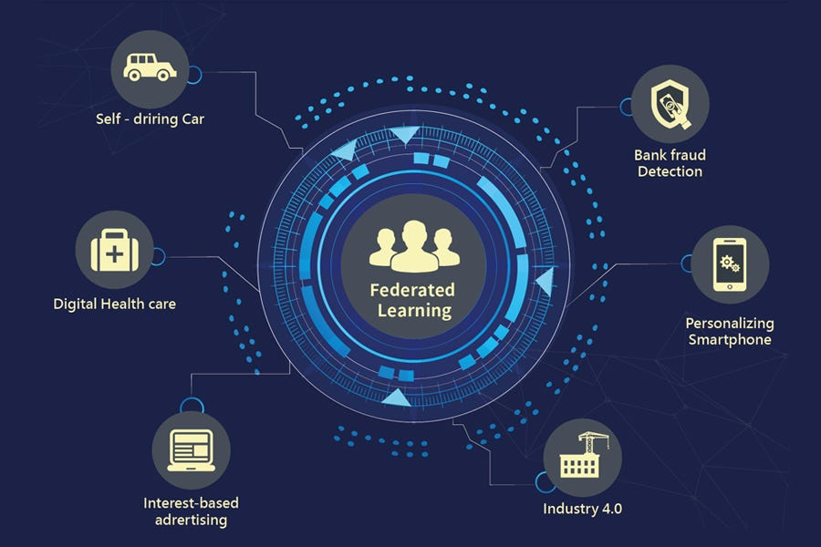
Federated Learning Security Model (Architecture View)
42/73
Decentralized Training Paradigm
Model training confined within institutional or device trust boundaries
Raw healthcare data never leaves its source environment
Security responsibility remains aligned with data ownership
Model Update Exposure Surface
Only gradients or model parameters are exchanged
Privacy risks migrate from data layer to model layer
Gradients become the primary target of inference attacks
Secure Communication & Aggregation
Encrypted transmission of local updates
Cryptographic secure aggregation prevents inspection of individual updates
Mitigates honest-but-curious server and peer threats
Distributed Global Model Formation
Iterative aggregation without centralized data pooling
Compromise of a single node has limited systemic impact
Security failures remain localized rather than catastrophic

Slide 43
43/73
Federated learning enforces data sovereignty while shifting security control to the model layer.
Myakala PK, Jonnalagadda AK, Bura C. Federated learning and data privacy: A review of challenges and opportunities. International Journal of Research Publication and Reviews. 2024 Dec 10;5(12):10-55248.
Dhiman G, Juneja S, Mohafez H, El-Bayoumy I, Sharma LK, Hadizadeh M, Islam MA, Viriyasitavat W, Khandaker MU. Federated learning approach to protect healthcare data over big data scenario. Sustainability. 2022 Feb 22;14(5):2500.

Slide 44
Security Landscape in Federated Learning:
Threats, Controls, and Defense Strategies
44/73
Threat Landscape | Inference Attacks Poisoning Attacks System-Level Threats
Layered Security Controls (Defense-in-Depth) | Model Layer: Differential Privacy, Gradient Clipping, Robust Aggregation (Median, Trimmed Mean) Communication Layer: Secure Aggregation Protocols, Encrypted Channels, Blockchain-Based Logging for Auditing System & Trust Layer: Client Authentication & Identity Management, Trust & Reputation Scoring, Anomaly Detection
Security Design Philosophy | Federated Learning is architecturally secure but not inherently threat-proof Security must be Proactive, not reactive and Integrated into architecture, not added later Smart healthcare requires Defense-in-Depth

Slide 45
45/73
Federated Learning is not security itself; it is a security-enabling architecture that must be carefully engineered and continuously reinforced
Chalamala SR, Kummari NK, Singh AK, Saibewar A, Chalavadi KM. Federated learning to comply with data protection regulations. CSI Transactions on ICT. 2022 Mar;10(1):47-60.
Zhang J, Zhu H, Wang F, Zhao J, Xu Q, Li H. Security and privacy threats to federated learning: Issues, methods, and challenges. Security and Communication Networks. 2022;2022(1):2886795.

Slide 46
Operational Security in Federated Learning: End-to-End Process
46/73
Secure Client Onboarding
Each healthcare organization or medical device is formally authenticated before joining FL.
Authentication methods are Digital certificates and Organizational credentials
Unauthorized or anonymous participants are excluded.
Local Training under Governance Policies
Models are trained locally following are Organizational security policies and Data governance and clinical requirements
No raw patient data leaves the organization.
Internal access control is enforced.
Secure and Protected Model Update Preparation
Local model updates are processed with Gradient clipping and Noise addition
Sensitive patterns are suppressed before sharing.

Slide 47
Operational Security in Federated Learning: End-to-End Process
47/73
Secure Aggregation without Trust Assumptions
Encrypted updates are sent to aggregation server.
Aggregation protocol ensures No individual update is exposed and No need to trust the central server
Controlled Distribution of Global Model
Aggregated model undergoes Validation and Versioning and integrity checks
Malicious behaviors can trigger rollback or exclusion.
Continuous Monitoring & Governance
All training rounds are logged and auditable.
Anomalous behaviors lead to Client isolation and Retraining or participant removal
Security is maintained throughout the learning lifecycle.

Slide 48
48/73
In healthcare, secure federated learning is not a single mechanism, but an operational process embedding security at every stage of the learning lifecycle.
Zhang H, Bosch J, Olsson HH. Real-time end-to-end federated learning: An automotive case study. In2021 IEEE 45th Annual Computers, Software, and Applications Conference (COMPSAC) 2021 Jul 12 (pp. 459-468). IEEE.
Ferrag MA, Friha O, Maglaras L, Janicke H, Shu L. Federated deep learning for cyber security in the internet of things: Concepts, applications, and experimental analysis. IEEe Access. 2021 Oct 6;9:138509-42.
Li Z, Wang L, Chen G, Zhang Z, Shafiq M, Gu Z. E2EGI: End-to-end gradient inversion in federated learning. IEEE Journal of Biomedical and Health Informatics. 2022 Sep 5;27(2):756-67.

Slide 49
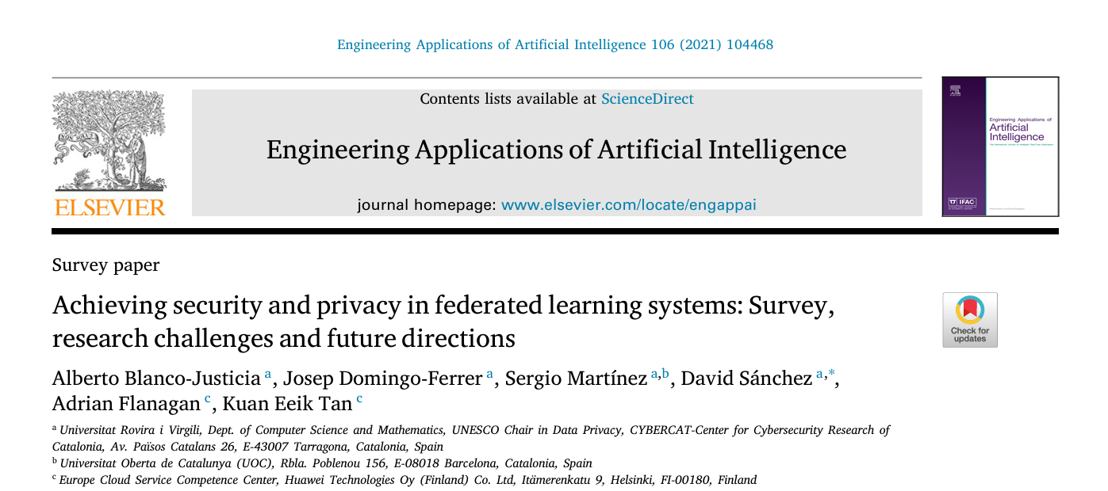
49/73

Slide 50
Methodology
50/73
Approach:
  Systematic survey of literature on FL
  Categorization of attacks and vulnerabilities:
  model poisoning
  inference attacks
  gradient leakage
  Analysis of defense mechanisms:
  secure aggregation
  differential privacy
  cryptography-based methods
Sample:
  Peer-reviewed papers on FL security and privacy
  Applications in healthcare, IoT, collaborative ML
Result:
  Identified strengths and weaknesses of each approach
  Highlighted trade-offs between accuracy, privacy, and security

Slide 51
Results and Discussion
51/73
Discussion:
  Security and privacy in FL are interdependent but often conflicting goals
  Current solutions optimize for one objective at the cost of the other
  Hybrid, multi-layered approaches are needed for balanced protection
  FL reduces raw data exposure but is not immune to attacks
  Secure aggregation & differential privacy protect privacy but may reduce model accuracy
  Remaining vulnerabilities: malicious clients, gradient leakage, identity spoofing

Slide 52
Limitations and Research Gaps
52/73
Limitations:
  Reliance on existing studies; limited empirical validation
  Computational overhead of cryptographic solutions
  Underexplored practical deployment issues in multi-institution scenarios
Future Directions:
  Design efficient, secure, and privacy-preserving FL frameworks.
  Evaluate trade-offs between privacy, security, and model performance.
  Investigate hybrid approaches combining DP, secure aggregation, blockchain, and anomaly detection.

Slide 53
Critique
53/73
Strengths:
  Comprehensive survey of FL security and privacy challenges
  Clear classification of attacks and defenses
  Highlights real-world relevance in healthcare and IoT
Limitations:
  Lacks empirical validation and benchmark comparisons
  Limited discussion on performance trade-offs
  Practical deployment issues underexplored
Insight:
  Excellent for conceptual understanding but needs quantitative analysis and case studies
  Future work should aim for integrated frameworks optimizing privacy, security, and model accuracy
  Bridging theory and practice is the key challenge in secure FL, especially in smart healthcare

Slide 54
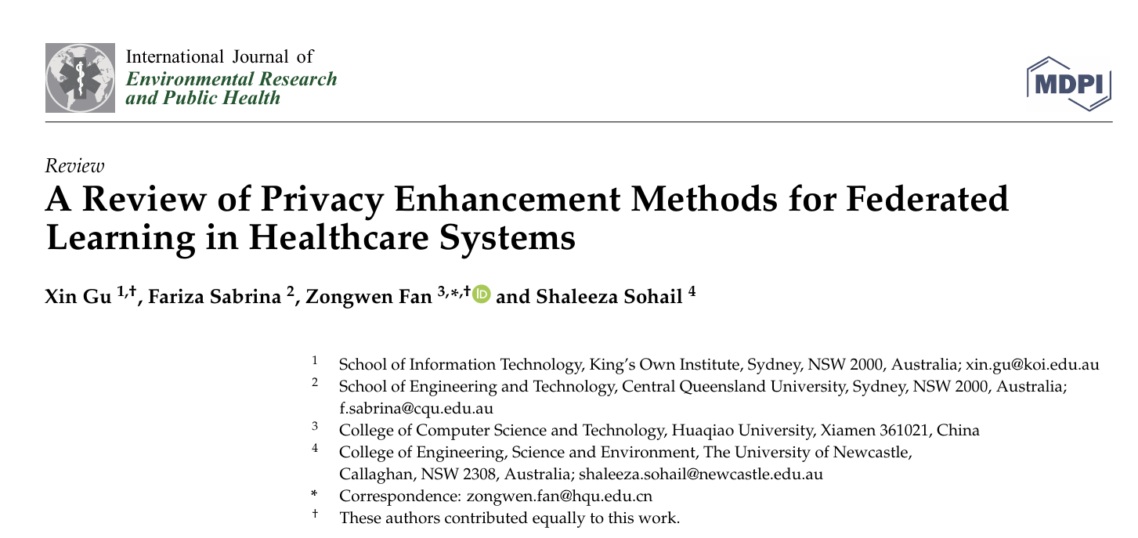
54/73

Slide 55
Methodology
55/73
Research Questions :
What privacy enhancement methods have been proposed for FL in healthcare?
What are the strengths, weaknesses, and trade‑offs of these methods?
What future directions exist?
Methodological Approach:
Systematic review using Scopus database search.
Boolean query: “federated learning” AND (“health” OR “ehealth”) AND (“privacy” OR “security” OR “trust”).
Screened 216 records → 40 relevant papers included.
Scope:
Literature from 2020–2023 focusing on privacy in FL healthcare applications.
Categories: Differential Privacy, Homomorphic Encryption, Blockchain, Hierarchical FL, Peer‑to‑Peer, Edge Intelligence, Mixed/Hybrid approaches.

Slide 56
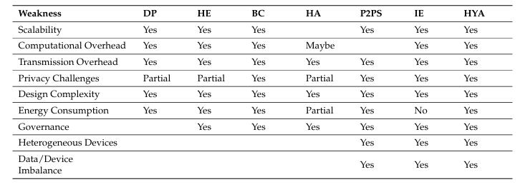
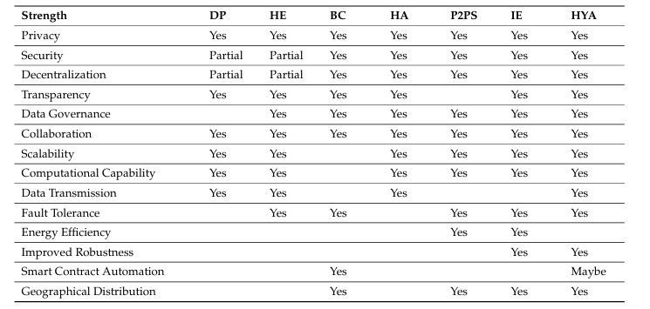
Key Findings & Discussion
56/73
Privacy Enhancement Methods:
Differential Privacy
Homomorphic Encryption
Blockchain
Hierarchical FL
Peer‑to‑Peer Sharing
Edge Intelligence
Mixed/Hybrid
Privacy Enhancement Methods Strengths:
DP provides quantifiable privacy; HE ensures encrypted computation
Blockchain improves transparency and governance
P2PS enhances scalability; Edge reduces communication latency
Privacy Enhancement Methods Weaknesses:
DP can degrade model accuracy
HE incurs high computation overhead
Blockchain scalability issues
Hybrid methods introduce complexity and performance challenges

Slide 57
Limitations and Future Directions
57/73
Limitations
Lack of unified privacy evaluation metrics for FL systems
Most methods trade privacy for performance
Integration complexity among techniques
Future Directions:
Designing scalable hybrid privacy techniques
Lightweight protocols for Medical IoT and edge devices
Standardized evaluation frameworks for privacy guarantees
Integration of multi‑party computation and zero‑knowledge proofs in FL blockchain systems

Slide 58
Critique
58/73
Strengths:
Comprehensive categorization of privacy techniques in FL specifically for healthcare.
Highlights real trade‑offs between privacy guarantees and utility/performance.
Draws attention to emerging techniques beyond DP & HE
Limitations:
Relies on secondary analysis no empirical benchmarking of the reviewed methods.
Lacks quantitative evaluation of privacy‑utility trade‑offs across real healthcare datasets.
The review mainly summarizes methods rather than proposes novel frameworks or evaluation criteria.
Insight:
Future work should focus on standardized benchmarks for privacy evaluation and real‑world deployment case studies in clinical settings.
Development of lightweight privacy protocols suitable for heterogeneous IoMT devices is crucial to practical applicability.

Slide 59
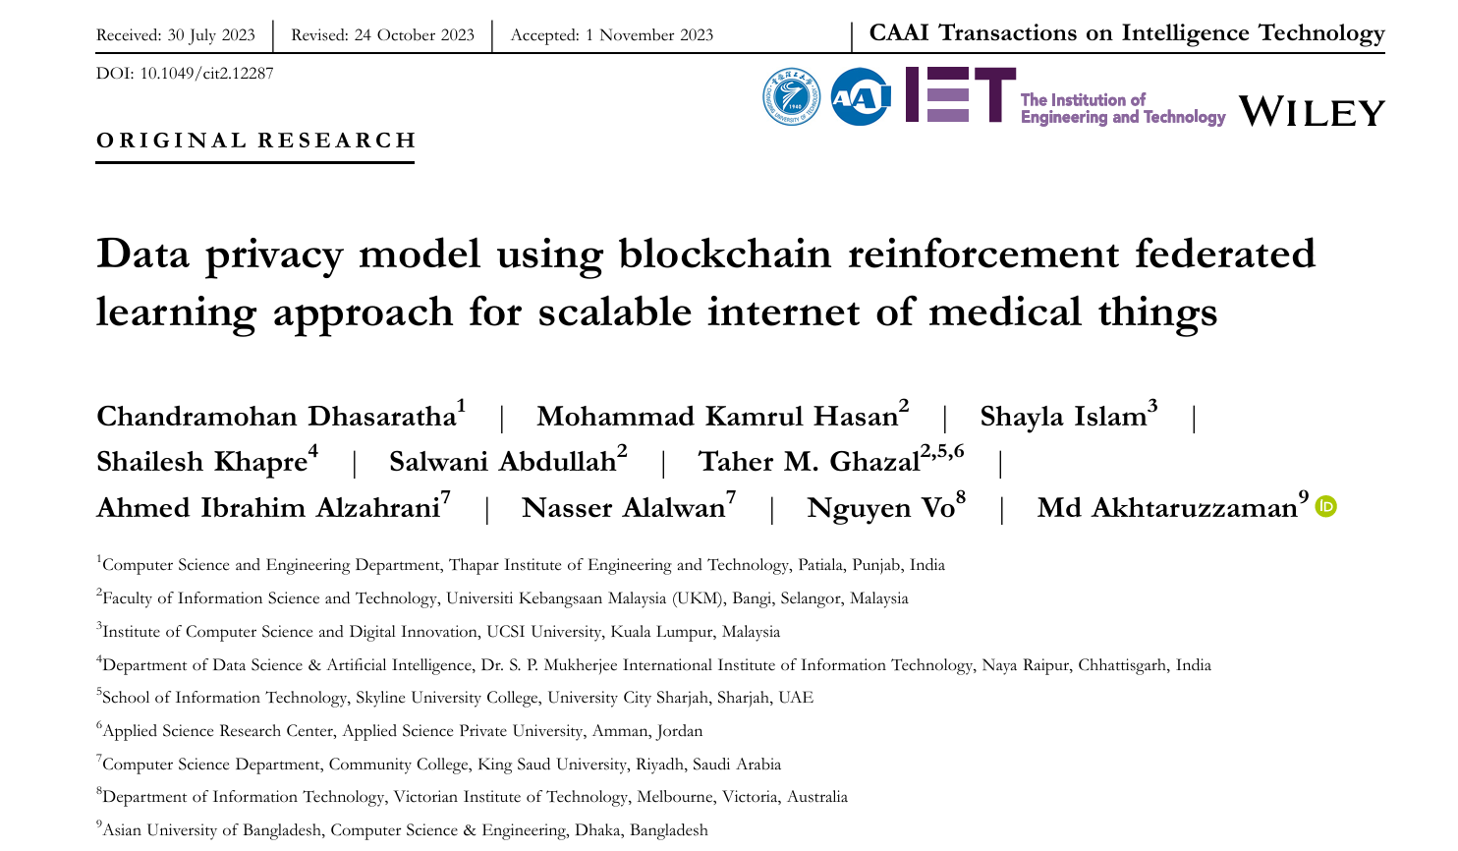
59/73

Slide 60
Methodology
60/73
Approach:
Combines Reinforcement Learning with Federated Learning for distributed model training.
Integrates Blockchain Technology as an immutable, decentralized mechanism for governance, transparency, and secure coordination.
Core Features:
Decentralized training
Blockchain coordination
Reinforcement Learning enhancement
Scope:
Applicable to post-COVID-19 patient data monitoring for clinical decision support.
Targets privacy preservation and secure communication in smart healthcare IoMT environments

Slide 61
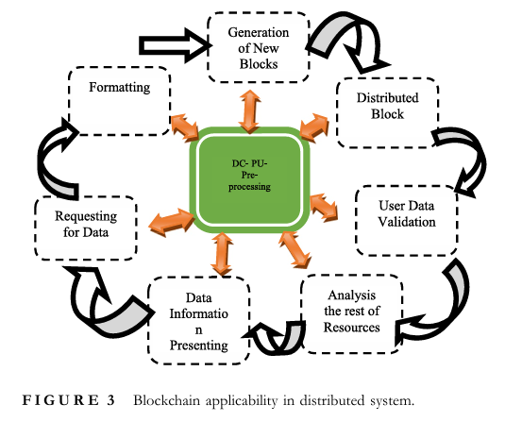
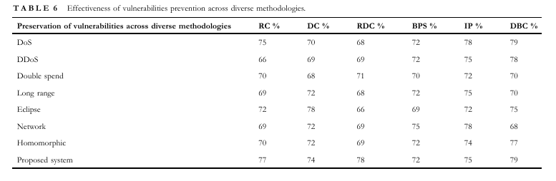
Results and Discussion
61/73
Results:
The proposed Blockchain-Reinforcement Federated Learning model improves reliability and privacy protection compared with baseline FL models.
Demonstrates comparatively higher performance and scalability in distributed healthcare settings.
Decentralized structure helps avoid intermediate dependency and reduces risk of data leakage.
Discussion:
Reinforcement learning assists in adaptive model update decisions under dynamic IoMT conditions.
Blockchain provides secure, immutable transaction records for aggregation coordination.
The approach aligns well with zero-trust and data minimization principles for healthcare data.
Suggests practical feasibility for real-world decentralized healthcare monitoring

Slide 62
Limitations and Future Directions
62/73
Limitations:
Computational overhead: Combining RL + FL + Blockchain increases complexity and processing cost.
Implementation constraints: Real-world IoMT devices often have limited resources which may impact feasibility.
Evaluation : Article summarizes overall improvements but excludes extensive empirical benchmarking on diverse healthcare datasets.
Future Directions:
Optimization of consensus mechanisms to reduce Blockchain transaction latency and computing cost.
Lightweight RL-FL hybrid models suitable for resource-constrained IoMT edge devices.
Comprehensive real-world deployments and benchmark comparisons across healthcare scenarios.
Privacy metrics and formal guarantees tailored to healthcare regulation compliance

Slide 63
Critique
63/73
Strengths:
Integrates three advanced paradigms ( Reinforcement Learning, Federated Learning, and Blockchain ) addressing privacy, security, and scalability simultaneously.
Offers a compelling architecture for decentralized clinical monitoring in IoMT, particularly for layered decision-making environments such as post-COVID-19 care.
Emphasizes secure, transparent communication and trustless coordination, relevant to smart healthcare contexts.
Limitations:
The hybrid model might suffer from high communication and consensus overhead in large IoMT networks.
Many IoMT devices are low-power and cannot efficiently support Blockchain operations or complex RL workflows.
The article could benefit from larger empirical evaluations, including diverse clinical datasets and real-time IoMT deployment experiments.
Insight:
Future research should focus on lightweight hybrid mechanisms, model compression, and Blockchain scaling to make B-RFL feasible for real IoMT ecosystems.
Introducing quantitative privacy metrics and formal robustness evaluations would strengthen scientific grounding for healthcare applications

Slide 64
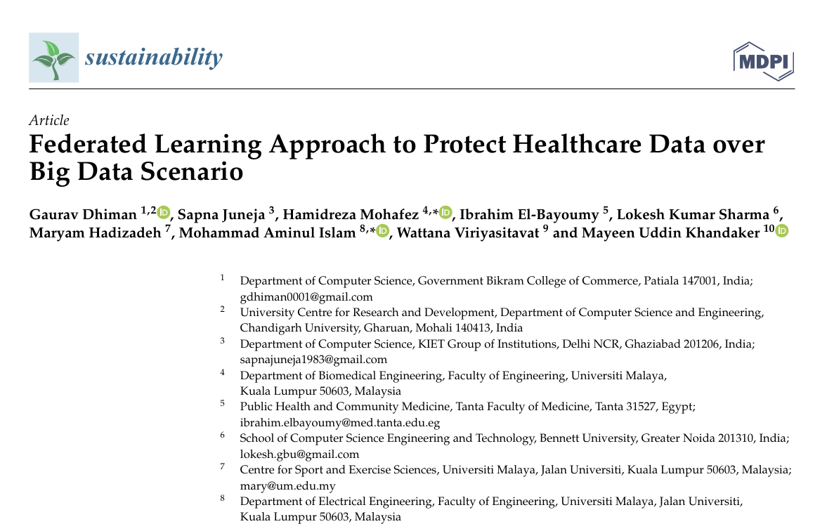
64/73

Slide 65
Methodology
65/73
Methodological Focus:
Architectural design
Privacy preservation
Scalability under Big Data constraints
Key Components:
Edge / Fog / Cloud hybrid architecture
Secure parameter exchange
Distributed aggregation server
Big-data preprocessing at local nodes
Data Scenario:
Large-scale healthcare datasets (EHRs, clinical records, sensor data)
High-volume, high-velocity medical data streams

Slide 66
Results and Discussion and Limitations
66/73
Results:
Federated Learning significantly reduces privacy risk compared to centralized ML
Demonstrates scalability for large healthcare datasets
Preserves model accuracy while avoiding raw data sharing
Discussion:
Big Data analytics and privacy are traditionally conflicting goals
FL reframes the problem by moving computation to data
Suitable for multi-hospital, cross-organizational learning environments
Enables collaborative analytics without violating data protection laws
Aligns with GDPR / HIPAA data minimization principles
Limitations:
Communication overhead with large numbers of clients
Vulnerability to model poisoning and malicious participants
Lack of formal privacy guarantees

Slide 67
Critique
67/73
Strengths:
Correctly identifies centralized Big Data analytics as a privacy anti-pattern in healthcare
Positions Federated Learning as an architectural security solution, not just a technical add-on
Highly relevant for national-scale health information systems
Limitations:
Security is treated mostly as data non-movement, not as a full threat model
Insider attacks and gradient leakage risks are under-discussed
Limited empirical evaluation under real hospital network conditions
Insight:
The article is strong conceptually but architecturally optimistic
In smart healthcare, FL is a necessary foundation but not a complete security solution
Federated Learning transforms healthcare Big Data analytics from a data-centric risk into a model-centric opportunity but only when embedded in a layered security architecture.

Slide 68
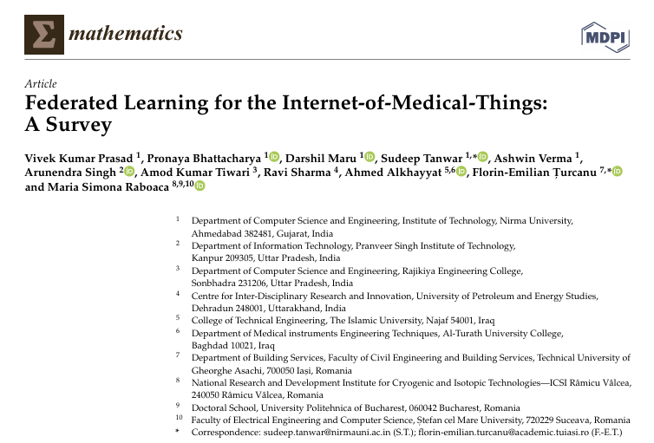
68/73

Slide 69
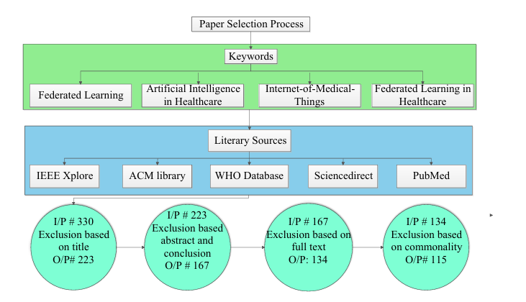
Methodology
69/73
Scope:
Federated Learning architectures in IoMT
Security & privacy challenges in medical IoT
FL-based healthcare use cases( Remote patient monitoring، Wearable devices، Smart hospitals)
Analytical Dimensions:
FL taxonomies
Threat models in IoMT
Communication, computation, and energy constraints
Regulatory compliance
Method:
Structured literature review
Comparative analysis of FL frameworks
Identification of open research challenges

Slide 70
Results and Discussion
70/73
Results:
IoMT generates high-frequency, highly sensitive, distributed data
Centralized ML is infeasible due to (Privacy risks ،Bandwidth constraints and Regulatory barriers)
Discussion:
Data locality reduced privacy exposure
Edge intelligence makes lower latency
Collaborative learning without data sharing

Slide 71
Limitations and Challenges
71/73
Challenges:
Model poisoning and Byzantine attacks
Gradient leakage and inference attacks
Lack of trust management among IoMT nodes
Limitations:
Limited computation and battery life
Unreliable network connectivity
Scalability under thousands of devices

Slide 72
Critique
72/73
Strengths:
Strong integration of (ML ، IoT ، Healthcare and Security perspectives)
Clearly identifies FL as an architectural response to IoMT risks
Limitations:
Security mechanisms are discussed descriptively rather than formally
Limited quantitative comparison between FL-IoMT frameworks
Real-world hospital-scale deployments remain largely theoretical
Insight:
This paper excels as a reference backbone for smart healthcare security research
Federated Learning transforms IoMT from a privacy liability into a secure intelligence fabric but only when embedded in a holistic security architecture.

Slide 73
73/73
THE
END
I sincerely appreciate your time and attention.
Hope for brighter and better days ahead for all of us.

